Slide 1
Daily Transactions Analysis
Presented by: Ashok Nagar
Tools: Python, Pandas, Seaborn, Matplotlib

Slide 2
Problem Description
The Daily Transactions project aims to analyze transaction data over a given period to identify patterns, anomalies, and trends. The analysis focuses on understanding transaction volume, frequency, and value distribution, providing insights for decision-making.

Slide 3
Key Insights
1. Transaction volumes peak during certain hours of the day, indicating high customer activity periods.
2. Certain categories of transactions contribute disproportionately to total revenue.
3. Seasonal variations impact transaction frequency.
4. High-value transactions are concentrated among a small customer segment.

Slide 4
Conclusion
The analysis of daily transactions reveals clear patterns in customer behavior and transaction flow. By leveraging these insights, the business can optimize operations, target marketing efforts, and enhance customer engagement strategies.

Slide 5
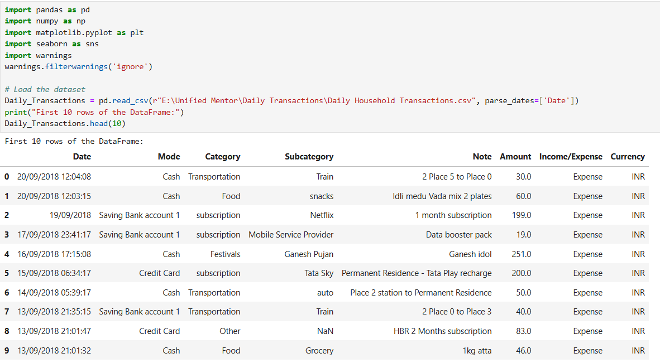
Python Code
Step 1: Import Libraries and Load Data

Slide 6
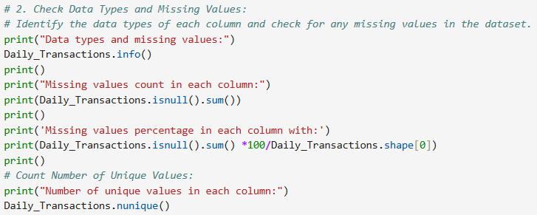
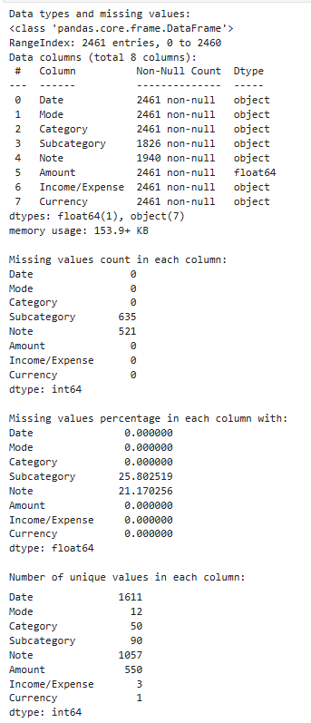
Step 2: Data Cleaning

Slide 7
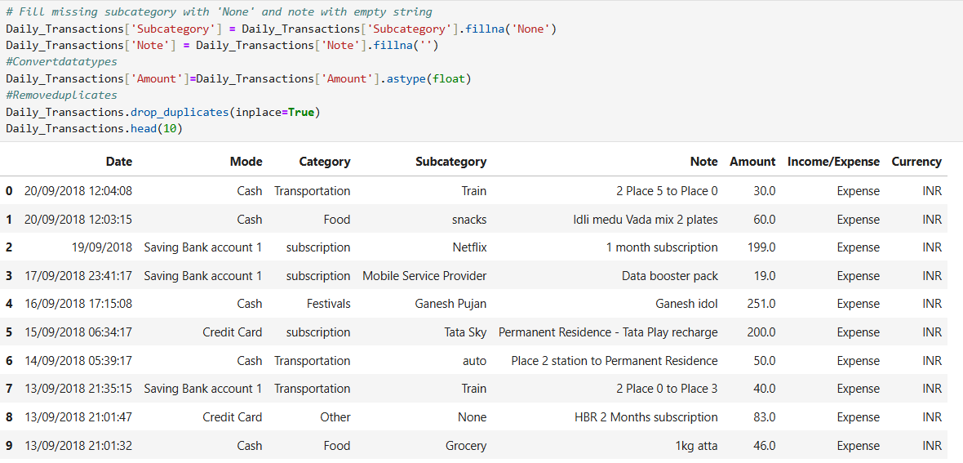

Slide 8
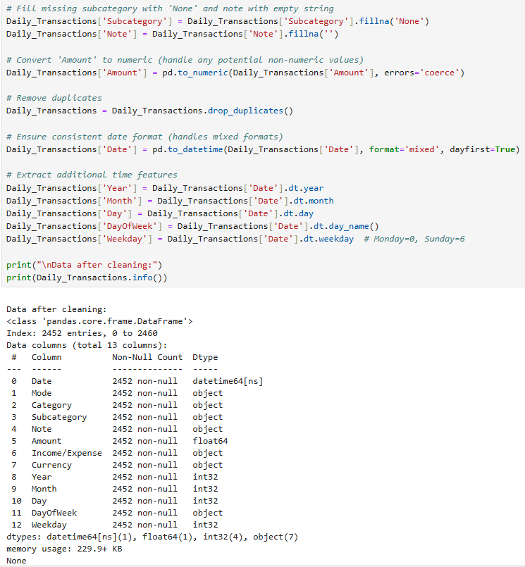

Slide 9
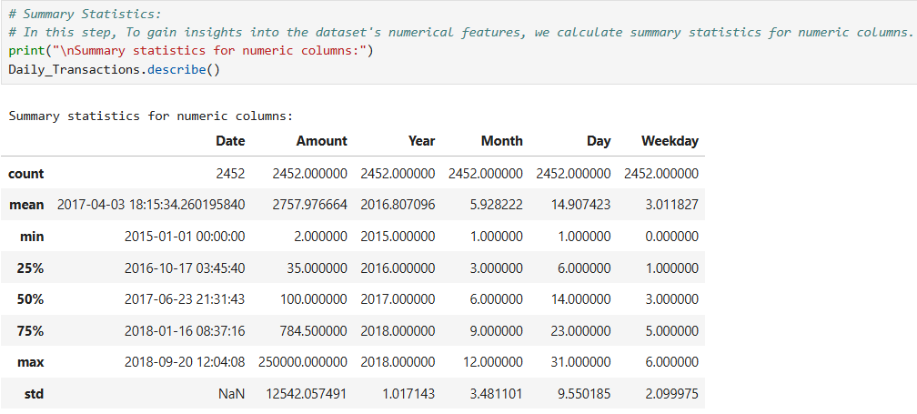
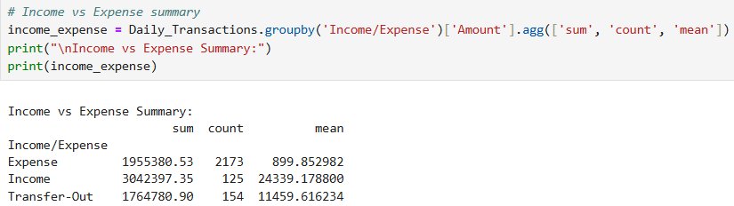
Step 3: Exploratory Data Analysis (EDA)

Slide 10
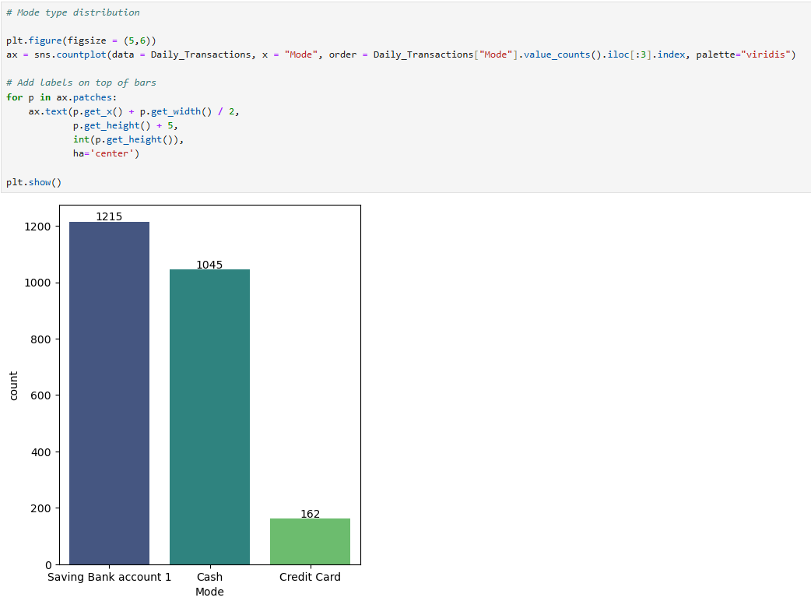

Slide 11
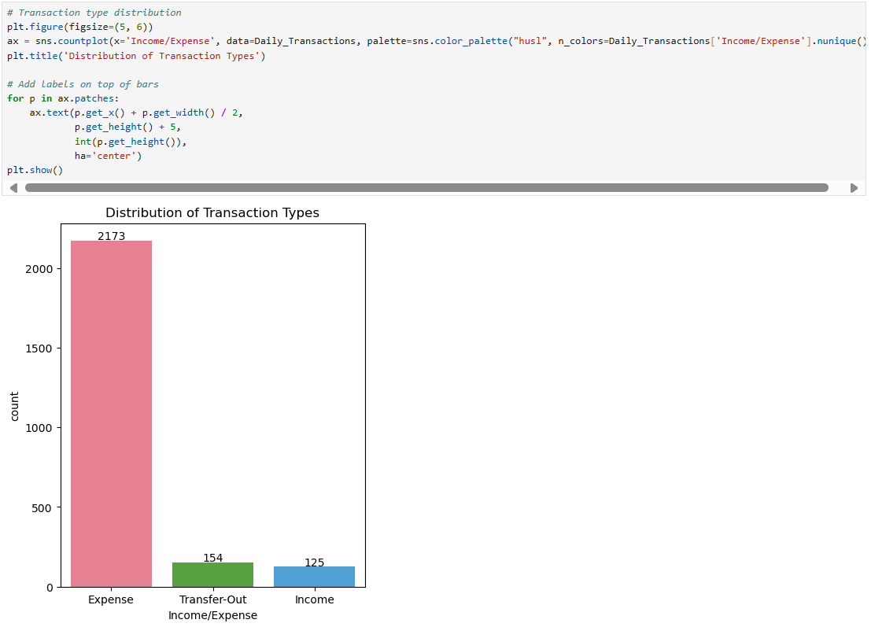

Slide 12
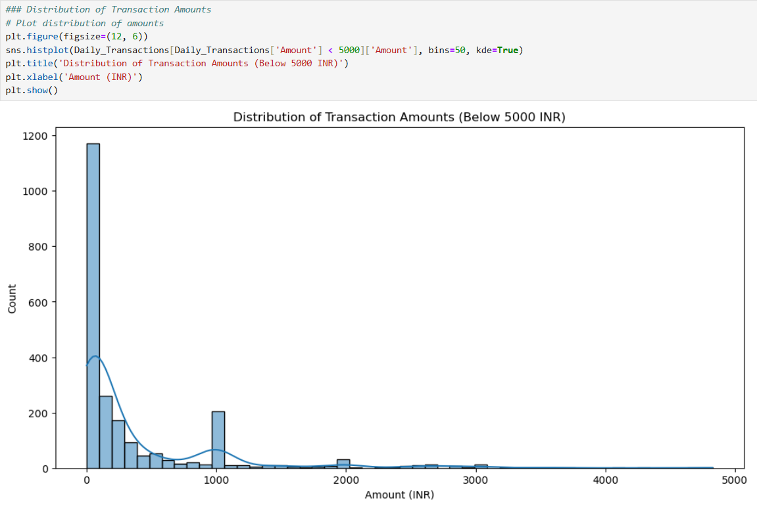

Slide 13
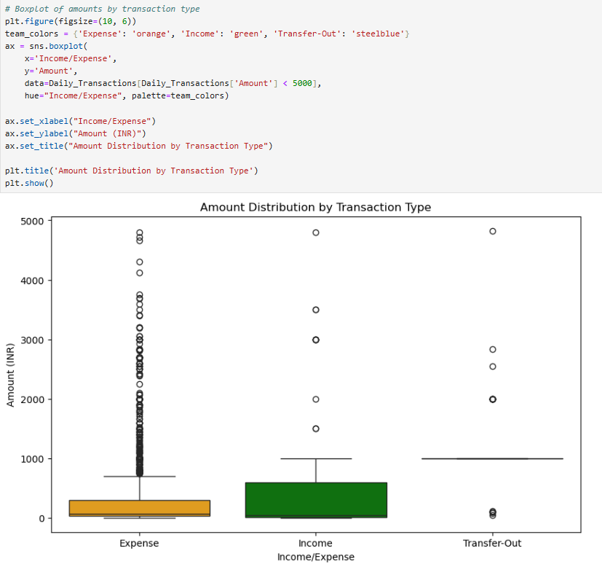

Slide 14
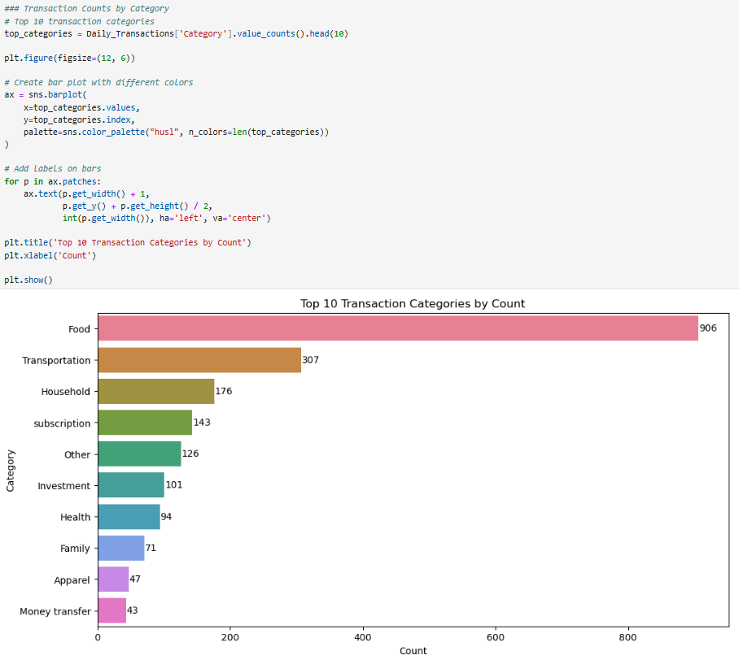

Slide 15
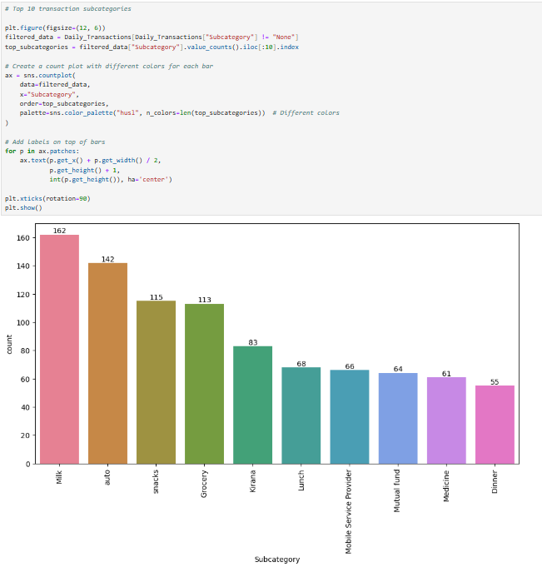

Slide 16
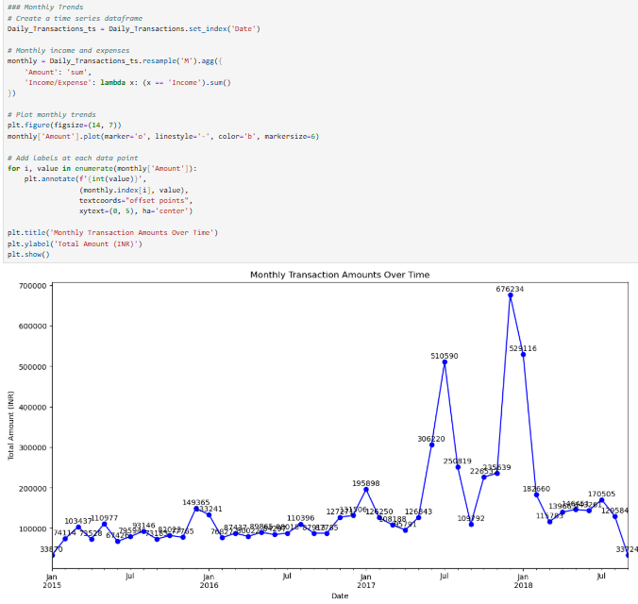
Step 4: Time Series Analysis

Slide 17
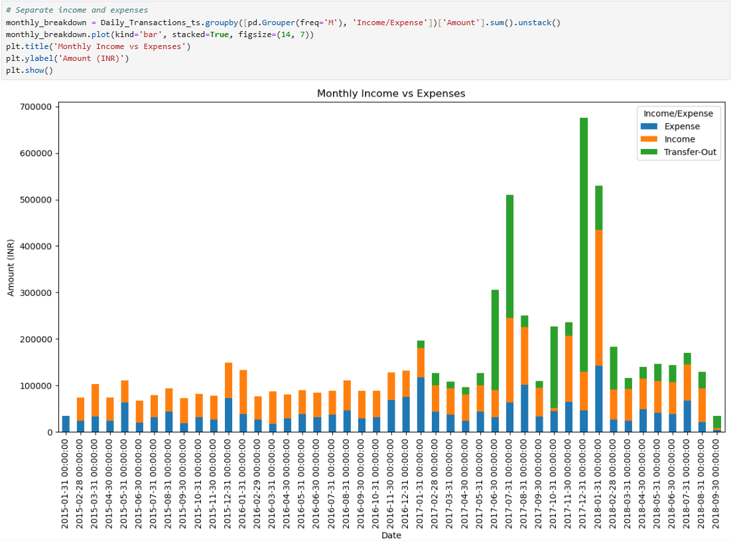

Slide 18
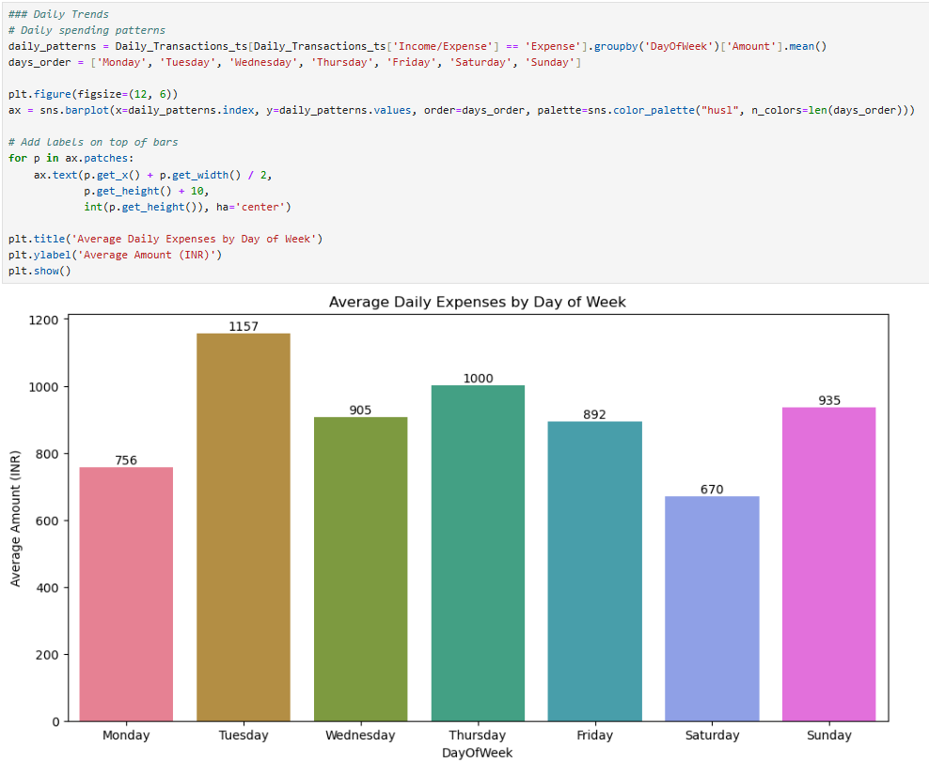

Slide 19
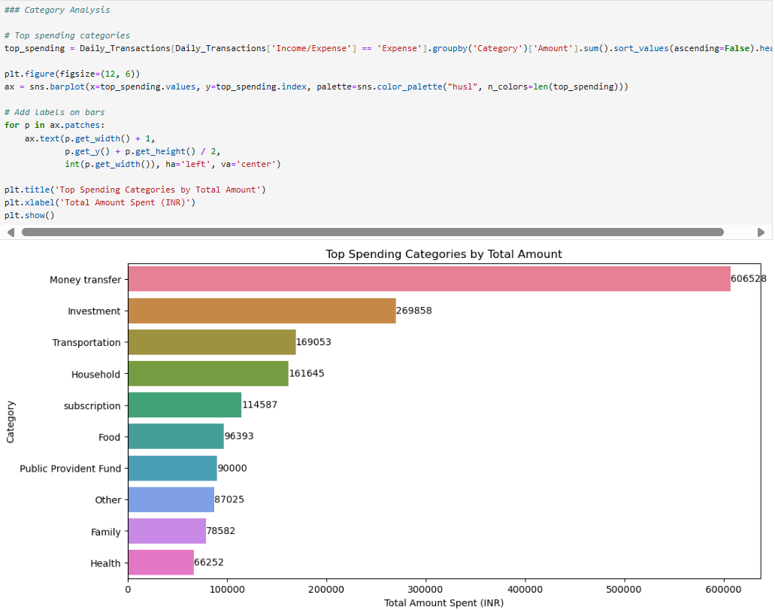
Step 5: Correlation Analysis

Slide 20
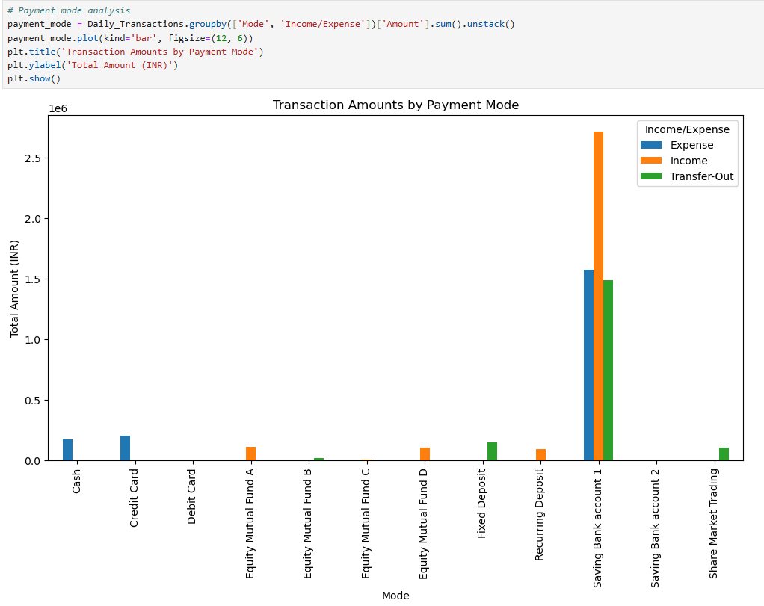

Slide 21
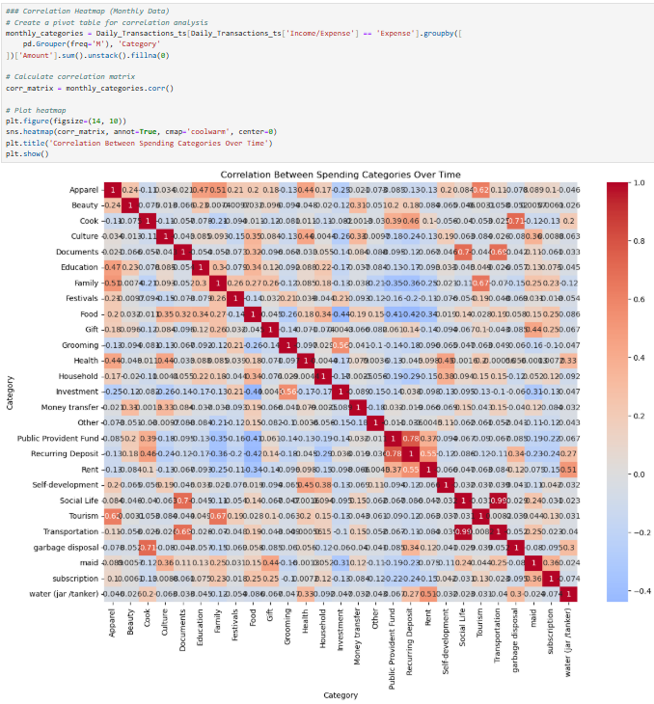

Slide 22
